Slide 1
CT004-3.5-3
Advanced Database Systems
SQL: Data Definition & Manipulation Language

Slide 2
Topic & Structure of Lesson
Purpose and importance of SQL.
How to retrieve data from database using SELECT and:
  Use compound WHERE conditions.
  Sort query results using ORDER BY.
  Use aggregate functions.

Slide 3
Topic & Structure of Lesson
  Group data using GROUP BY and HAVING.
  Use subqueries
  Join tables together.
How to update database using INSERT, UPDATE, and DELETE.

Slide 4
Key Terms you must be able to use
If you have mastered this topic, you should be able to use the
following terms correctly in your assignments and exams:
DDL (Data Definition Language)
DML (Data Manipulation Language)
CREATE TABLE
INSERT INTO …. VALUES
SELECT … FROM …. WHERE
GROUP BY, HAVING, ORDER BY
DISTINCT
IN, NOT IN, LIKE

Slide 5
Key Terms you must be able to use
If you have mastered this topic, you should be able to use the following terms correctly in your assignments and exams:
NULL, IS NOT NULL
COUNT, SUM, AVG, MIN, MAX
JOIN
EXISTS, NOT EXISTS
UPDATE … FROM … WHERE

Slide 6
Objectives of SQL
Ideally, database language should allow user to:
  create the database and relation structures;
  perform insertion, modification, deletion of data from relations;
  perform simple and complex queries.

Slide 7
Objectives of SQL
SQL is a transform-oriented language with 3 major components:
  A DDL for defining database structure.
  A DML for retrieving and updating data.
  A DCL for control access to data in a database.

Slide 8
Objectives of SQL
Consists of standard English words:
1) CREATE TABLE Staff(staffNo VARCHAR(5),
lName VARCHAR(15),
  salary DECIMAL(7,2));
2) INSERT INTO Staff VALUES (‘SG16’, ‘Brown’, 8300);
3) SELECT staffNo, lName, salary
FROM Staff
WHERE salary > 10000;

Slide 9
SELECT Statement
  SELECT [DISTINCT | ALL]
  {* | [columnExpression [AS newName]] [,...] }
  FROM TableName [alias] [, ...]
  [WHERE condition]
  [GROUP BY columnList] [HAVING condition]
  [ORDER BY columnList]

Slide 10
SELECT Statement
SELECT Specifies which columns are to
  appear in output.
FROM Specifies table(s) to be used.
WHERE Filters rows.
GROUP BY Forms groups of rows with same
  column value.
HAVING Filters groups subject to some
  condition.
ORDER BY Specifies the order of the output.

Slide 11
SELECT Statement
Order of the clauses cannot be changed.
Only SELECT and FROM are mandatory.

Slide 12
Example: All Columns, All Rows
List full details of all staff.
SELECT staffNo, fName, lName, position, gender, DOB, salary, branchNo
  FROM Staff;
Can use * as an abbreviation for ‘all columns’:
  SELECT *
  FROM Staff;

Slide 13
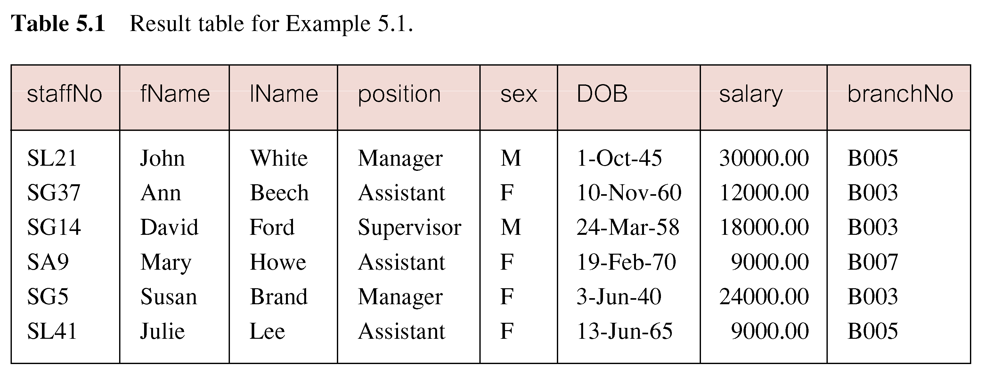
Example: All Columns, All Rows

Slide 14
Example: Specific Columns, All Rows
Produce a list of salaries for all staff, showing only staff number, first and last names, and salary.
  SELECT staffNo, fName, lName, salary
  FROM Staff;

Slide 15
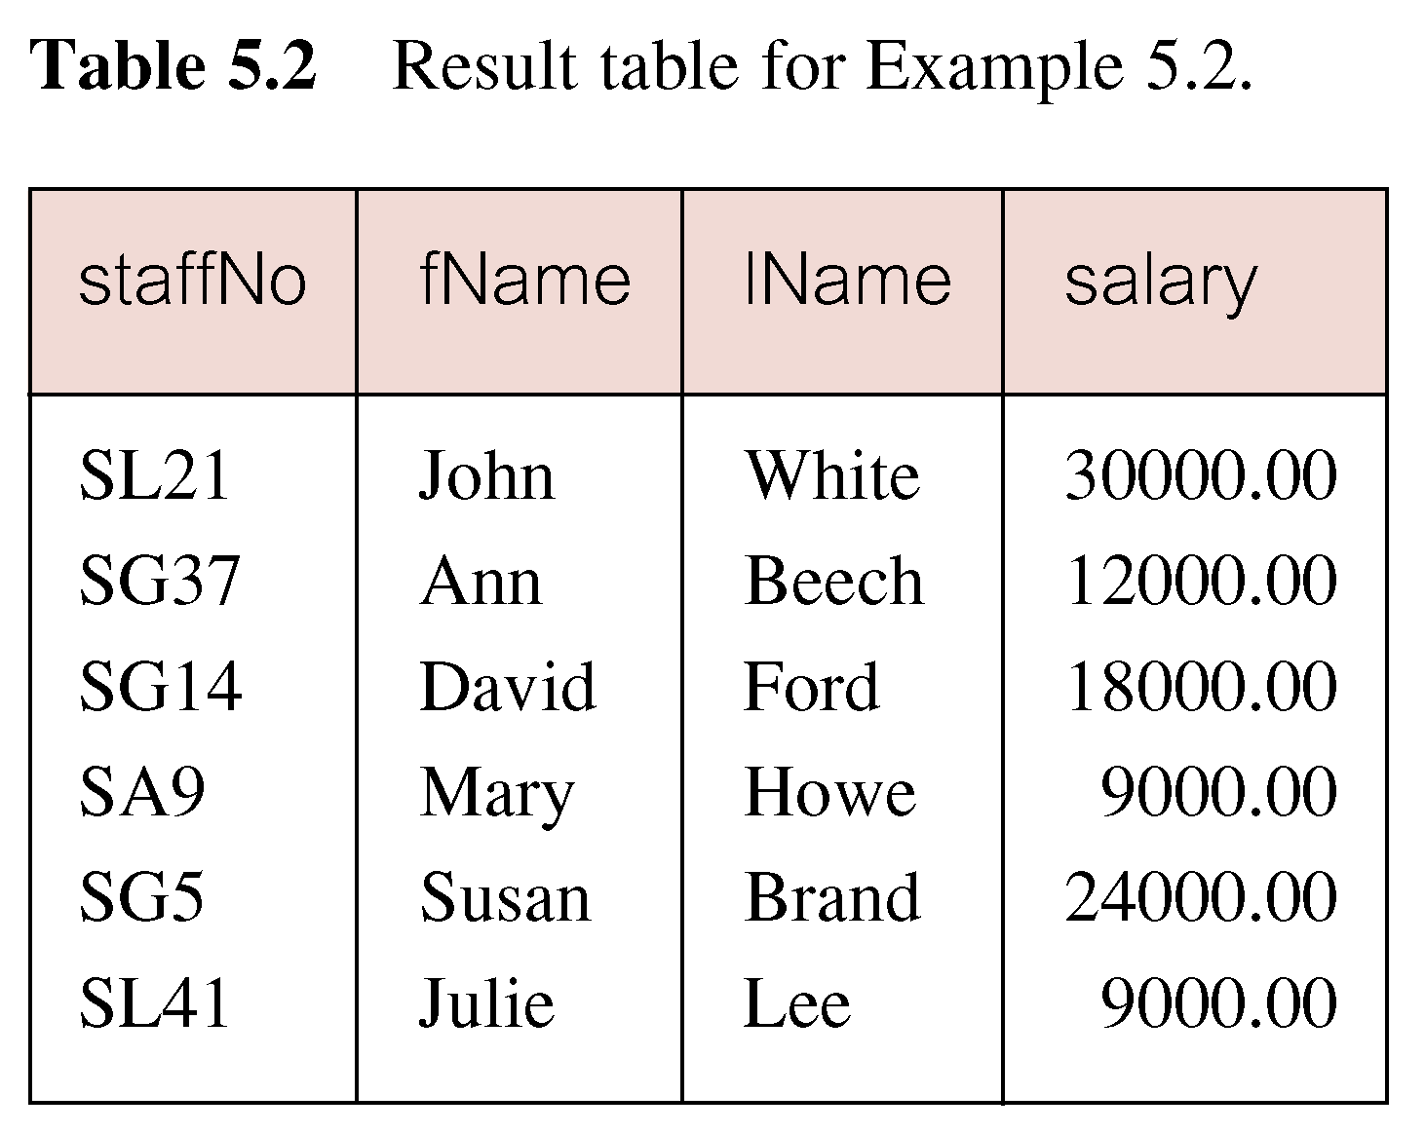
Example: Specific Columns, All Rows

Slide 16
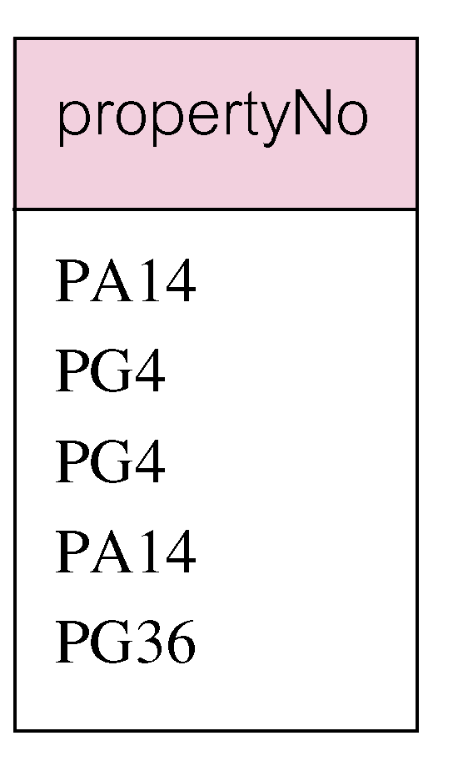
Example: Use of DISTINCT
List the property numbers of all properties that have been viewed.
SELECT propertyNo
  FROM Viewing;

Slide 17
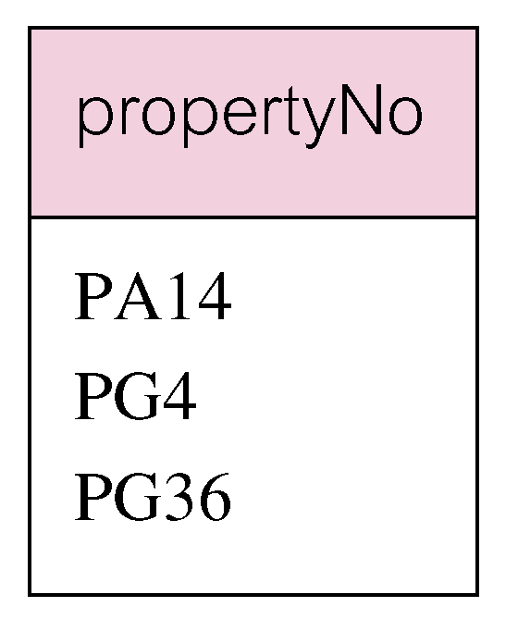
Example : Use of DISTINCT
Use DISTINCT to eliminate duplicates:
SELECT DISTINCT propertyNo
  FROM Viewing;

Slide 18
Example: Calculated Fields
Produce a list of monthly salaries for all staff, showing staff number, first and last names, and salary details.
SELECT staffNo, fName, lName, salary/12
FROM Staff;

Slide 19
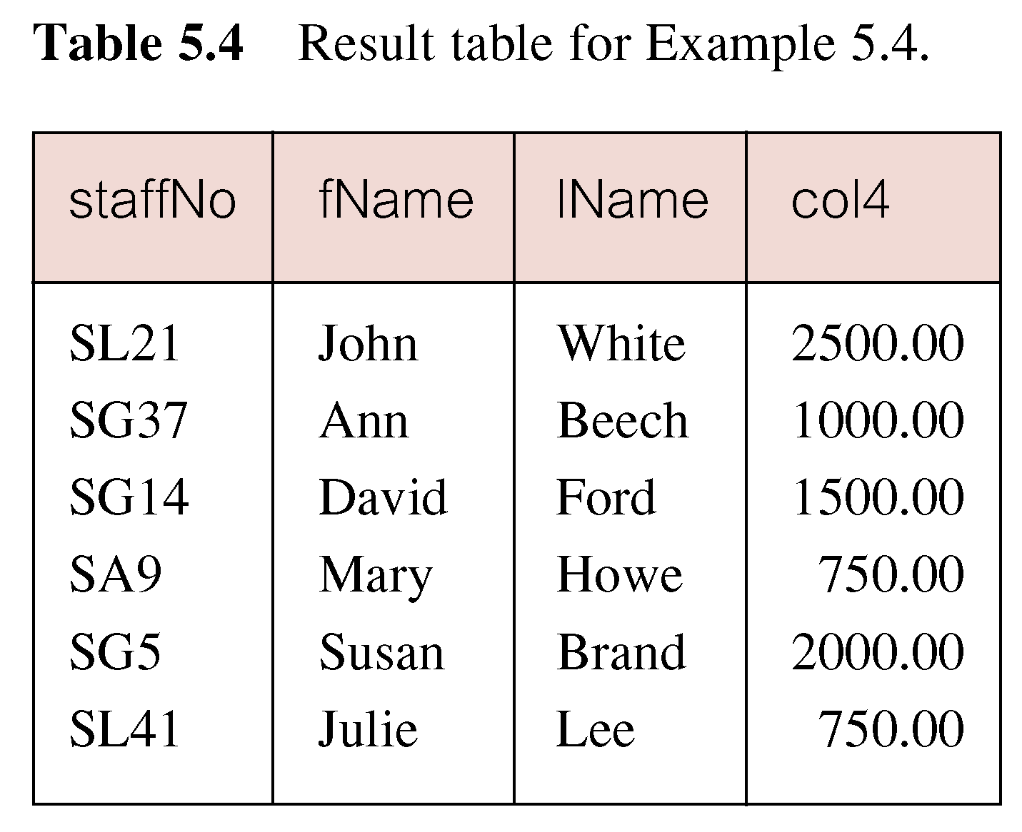
Example: Calculated Fields

Slide 20
Example: Calculated Fields
To name column, use AS clause:
SELECT staffNo, fName, lName, salary/12
  AS monthlySalary
  FROM Staff;

Slide 21
Example: Comparison Search Condition
List all staff with a salary greater than 10,000.
SELECT staffNo, fName, lName, position, salary
  FROM Staff
  WHERE salary > 10000;

Slide 22
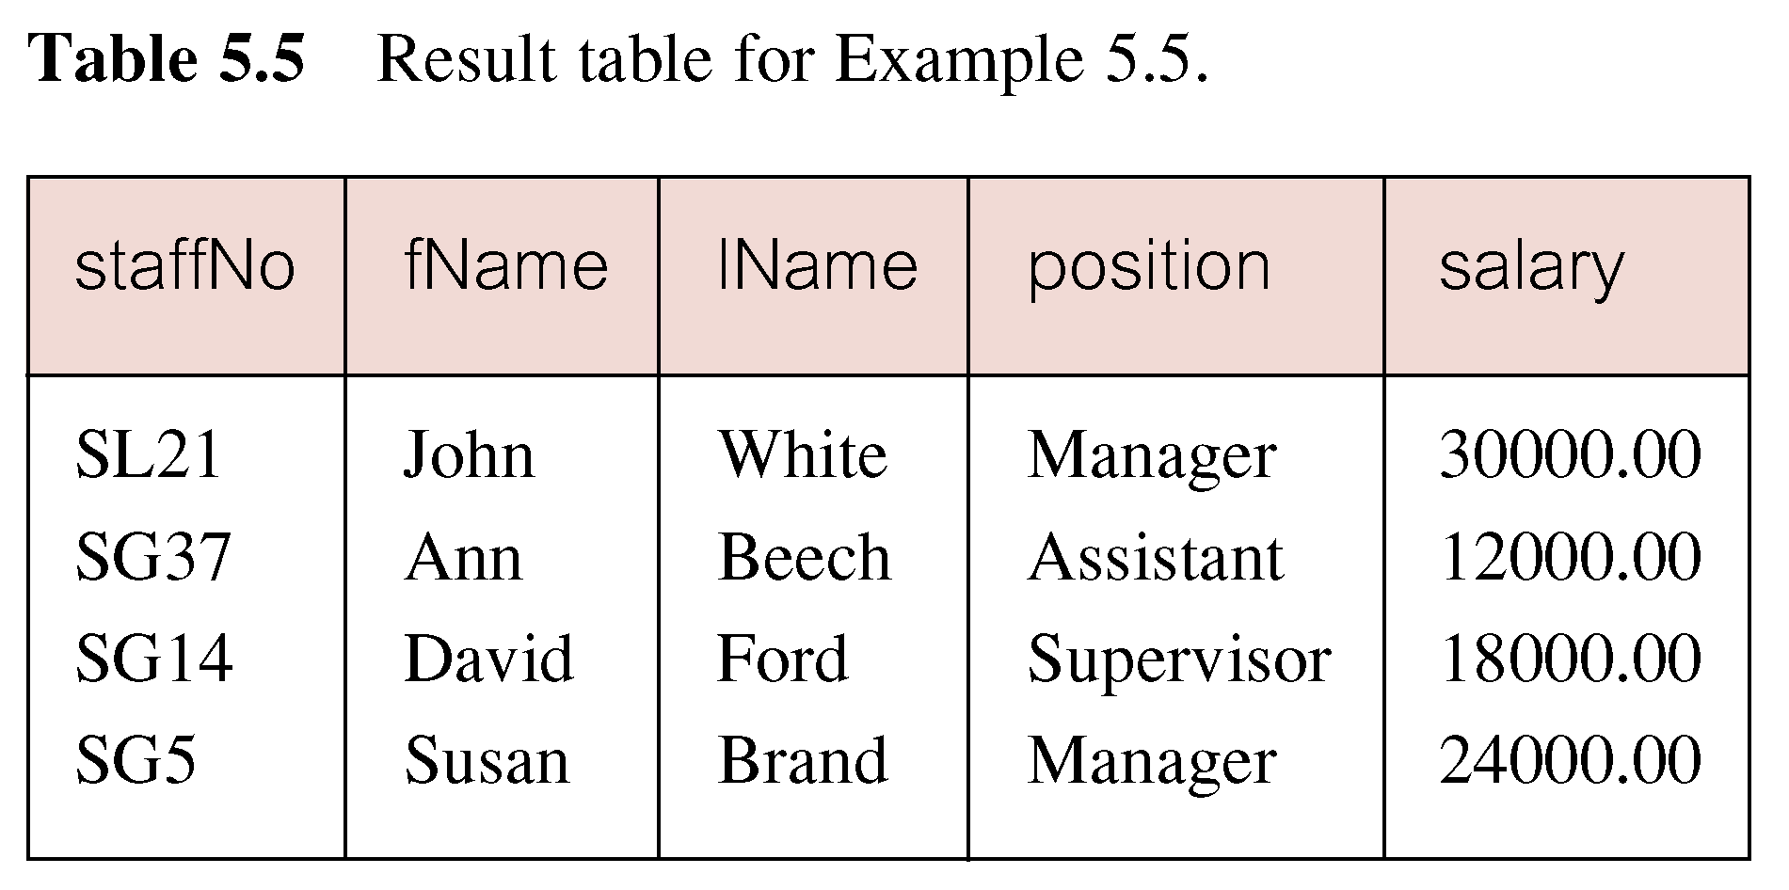
Example: Comparison Search Condition

Slide 23
Example: Compound Comparison Search Condition
List addresses of all branch offices in London or Glasgow.
SELECT *
  FROM Branch
  WHERE city = ‘London’ OR city = ‘Glasgow’;

Slide 24
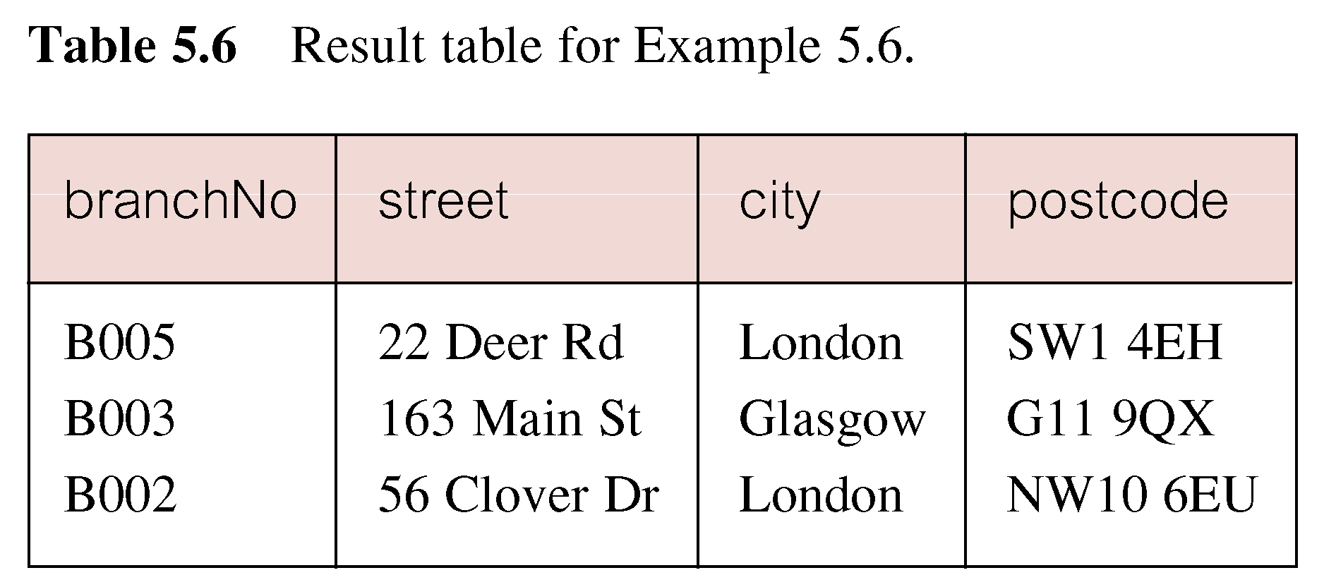
Example: Compound Comparison Search Condition

Slide 25
Example: Range Search Condition
List all staff with a salary between 20,000 and 30,000.
SELECT staffNo, fName, lName, position, salary
  FROM Staff
  WHERE salary BETWEEN 20000 AND 30000;
BETWEEN test includes the endpoints of range.

Slide 26
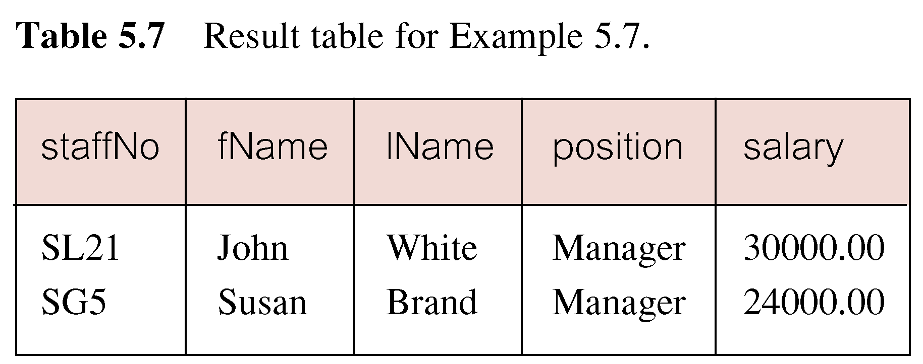
Example: Range Search Condition

Slide 27
Example: Range Search Condition
Also a negated version NOT BETWEEN.
BETWEEN does not add much to SQL’s expressive power. Could also write:
SELECT staffNo, fName, lName, position, salary
  FROM Staff
  WHERE salary>=20000 AND salary <= 30000;
Useful, though, for a range of values.

Slide 28
Example: Set Membership
List all managers and supervisors.
  SELECT staffNo, fName, lName, position
  FROM Staff
  WHERE position IN (‘Manager’, ‘Supervisor’);

Slide 29
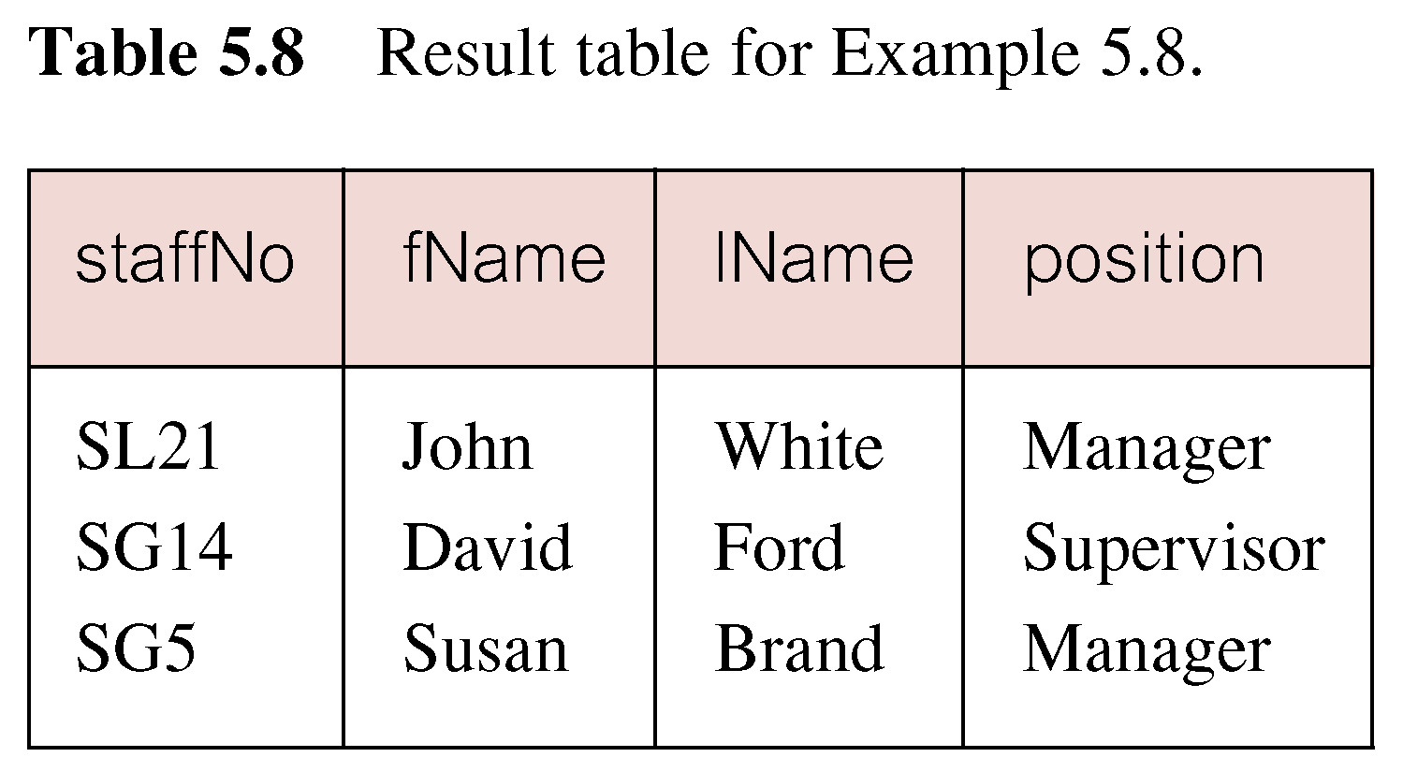
Example: Set Membership

Slide 30
Example: Set Membership
There is a negated version (NOT IN).
IN does not add much to SQL’s expressive power.
Could have expressed this as:
  SELECT staffNo, fName, lName, position
  FROM Staff
  WHERE position=‘Manager’ OR
  position=‘Supervisor’;
IN is more efficient when set contains many values

Slide 31
Example: Pattern Matching
Find all owners with the string ‘Glasgow’ in their address.
SELECT clientNo, fName, lName, address, telNo
  FROM PrivateOwner
  WHERE address LIKE ‘%Glasgow%’;

Slide 32
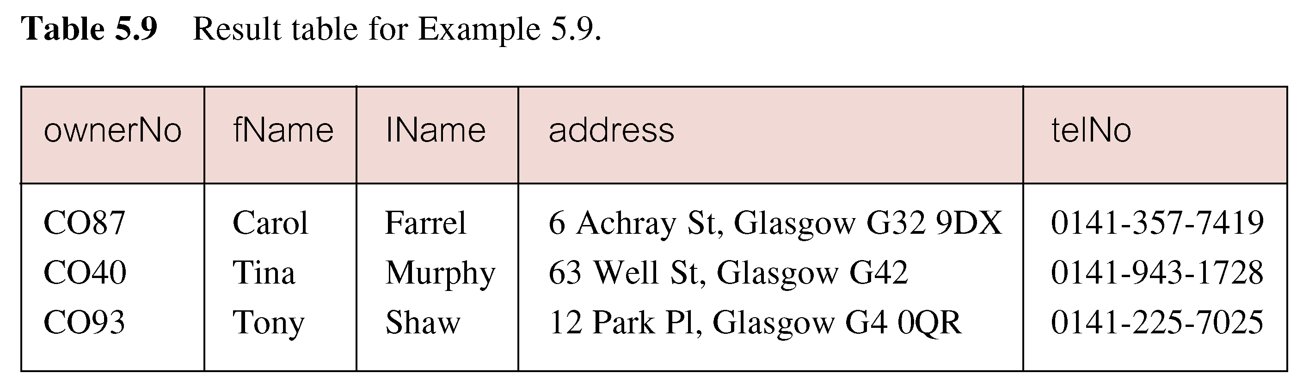
Example: Pattern Matching

Slide 33
Example: Pattern Matching
SQL has two special pattern matching symbols:
  %: sequence of zero or more characters;
  _ (underscore): any single character.
LIKE ‘%Glasgow%’ means a sequence of characters of any length containing ‘Glasgow’.

Slide 34
Example: NULL Search Condition
List details of all viewings on property PG4 where a comment has not been supplied.
There are 2 viewings for property PG4, one with and one without a comment.
Have to test for null explicitly using special keyword IS NULL:
SELECT clientNo, viewDate
  FROM Viewing
  WHERE propertyNo = ‘PG4’ AND
  comment IS NULL;

Slide 35
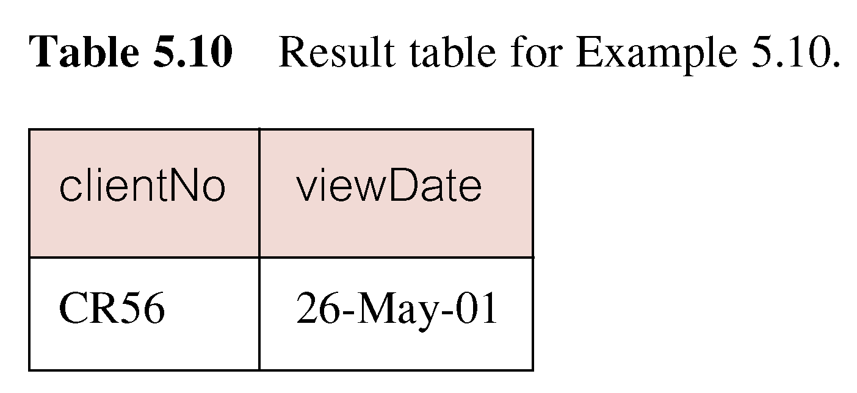
Example: NULL Search Condition
Negated version (IS NOT NULL) can test for non-null values.

Slide 36
Example: Single Column Ordering
List salaries for all staff, arranged in descending order of salary.
SELECT staffNo, fName, lName, salary
  FROM Staff
  ORDER BY salary DESC;

Slide 37
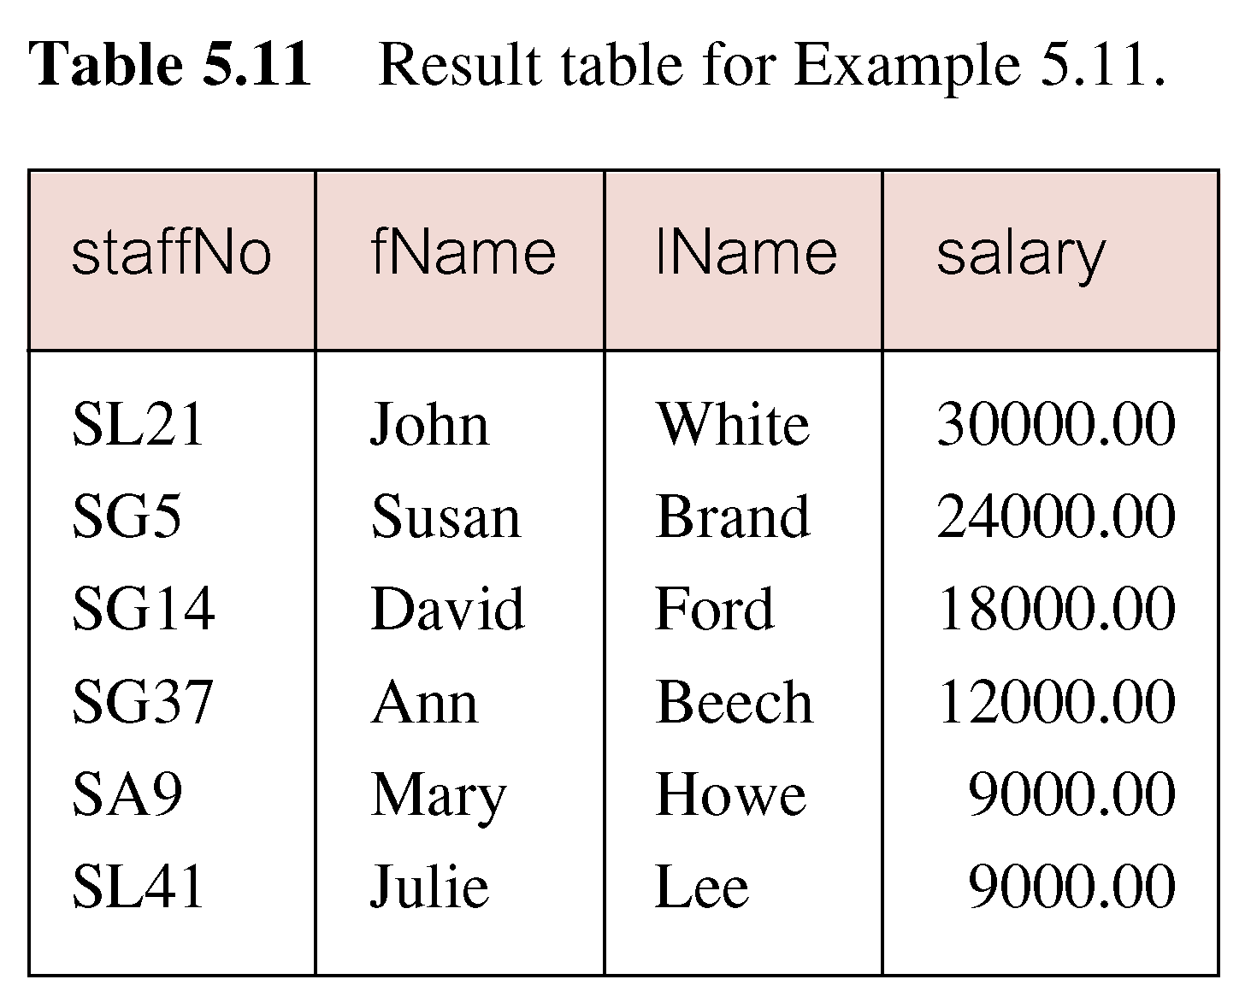
Example: Single Column Ordering

Slide 38
Example: Multiple Column Ordering
Produce abbreviated list of properties in order of property type.
SELECT propertyNo, type, rooms,rent
FROM PropertyForRent
  ORDER BY type;

Slide 39
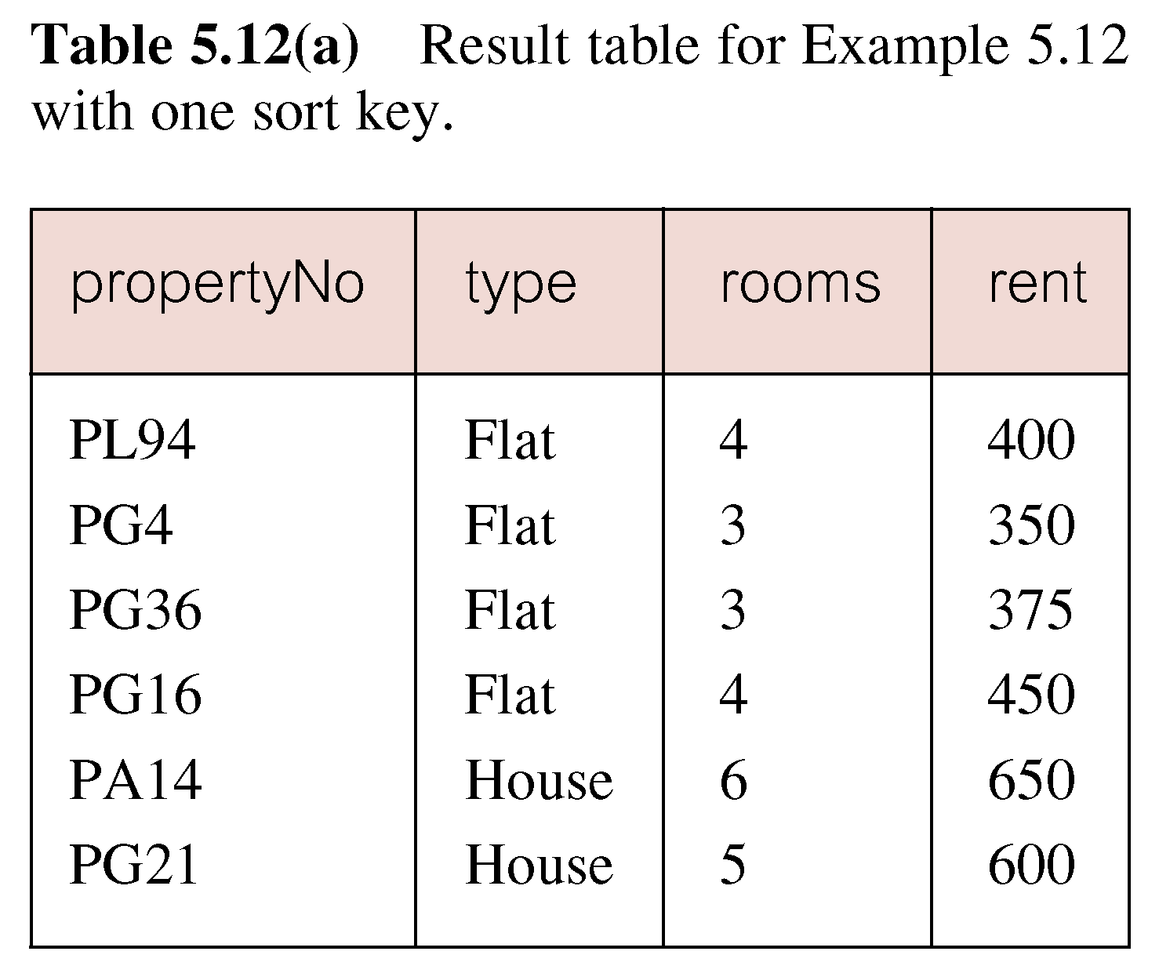
Example: Multiple Column Ordering

Slide 40
Example: Multiple Column Ordering
Four flats in this list - as no minor sort key specified, system arranges these rows in any order it chooses.
To arrange in order of rent, specify minor order:
SELECT propertyNo, type, rooms, rent
  FROM PropertyForRent
  ORDER BY type, rent DESC;

Slide 41
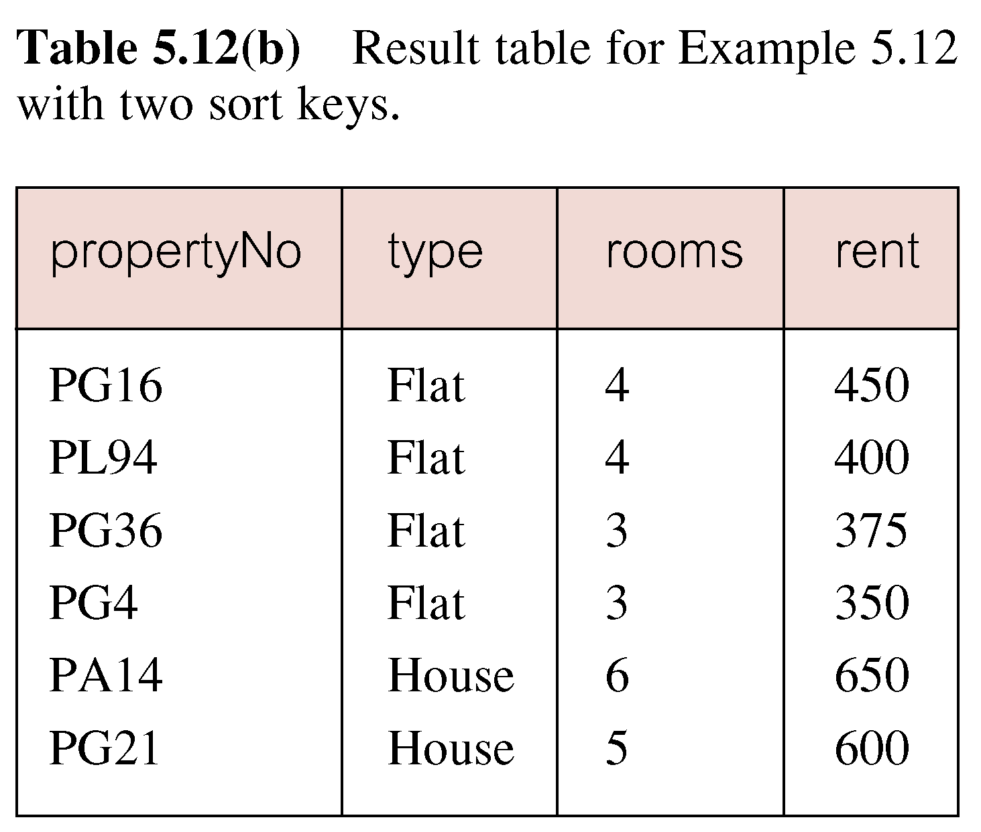
Example: Multiple Column Ordering

Slide 42
SELECT Statement - Aggregates
ISO standard defines five aggregate functions:
COUNT returns number of values in specified column.
SUM returns sum of values in specified column.
AVG returns average of values in specified column.
MIN returns smallest value in specified column.
MAX returns largest value in specified column.

Slide 43
SELECT Statement - Aggregates
Each operates on a single column of a table and returns a single value.
COUNT, MIN, and MAX apply to numeric and non-numeric fields, but SUM and AVG may be used on numeric fields only.
Apart from COUNT(*), each function eliminates nulls first and operates only on remaining non-null values.

Slide 44
SELECT Statement - Aggregates
COUNT(*) counts all rows of a table, regardless of whether nulls or duplicate values occur.
Can use DISTINCT before column name to eliminate duplicates.
DISTINCT has no effect with MIN/MAX, but may have with SUM/AVG.

Slide 45
SELECT Statement - Aggregates
Aggregate functions can be used only in SELECT list and in HAVING clause.
If SELECT list includes an aggregate function and there is no GROUP BY clause, SELECT list cannot reference a column out with an aggregate function. For example, the following is illegal:
SELECT staffNo, COUNT(salary)
  FROM Staff;

Slide 46
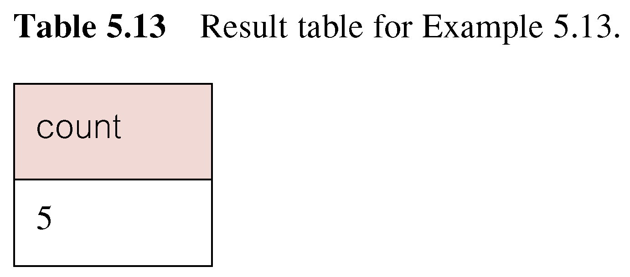
Example: Use of COUNT(*)
How many properties cost more than £350 per month to rent?
SELECT COUNT(*) AS count
  FROM PropertyForRent
  WHERE rent > 350;

Slide 47
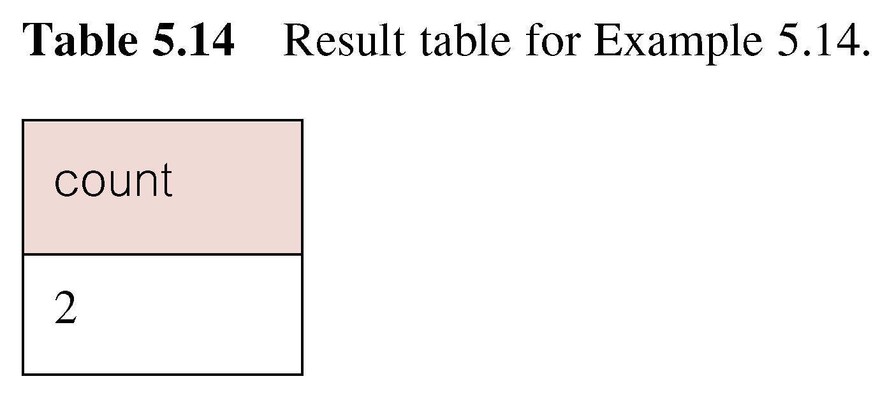
Example: Use of COUNT(DISTINCT)
How many different properties viewed in May ‘01?
SELECT COUNT(DISTINCT propertyNo) AS count
FROM Viewing
WHERE viewDate BETWEEN ‘1-May-01’AND ‘31-May-01’;

Slide 48
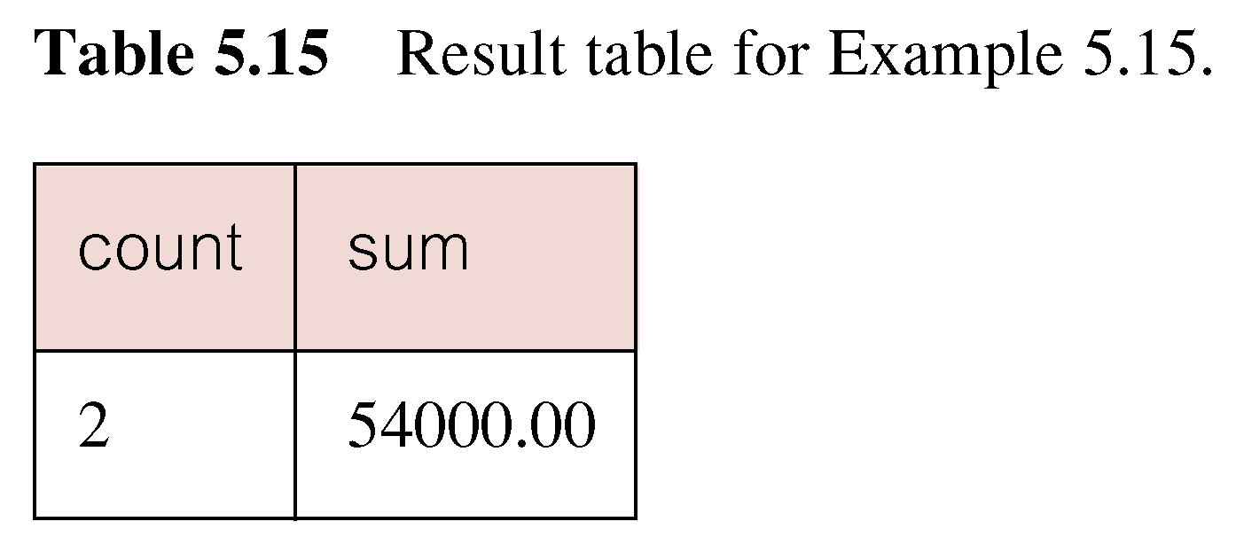
Example: Use of COUNT and SUM
Find number of Managers and sum of their salaries.
SELECT COUNT(staffNo) AS count,
  SUM(salary) AS sum
  FROM Staff
  WHERE position = ‘Manager’;

Slide 49
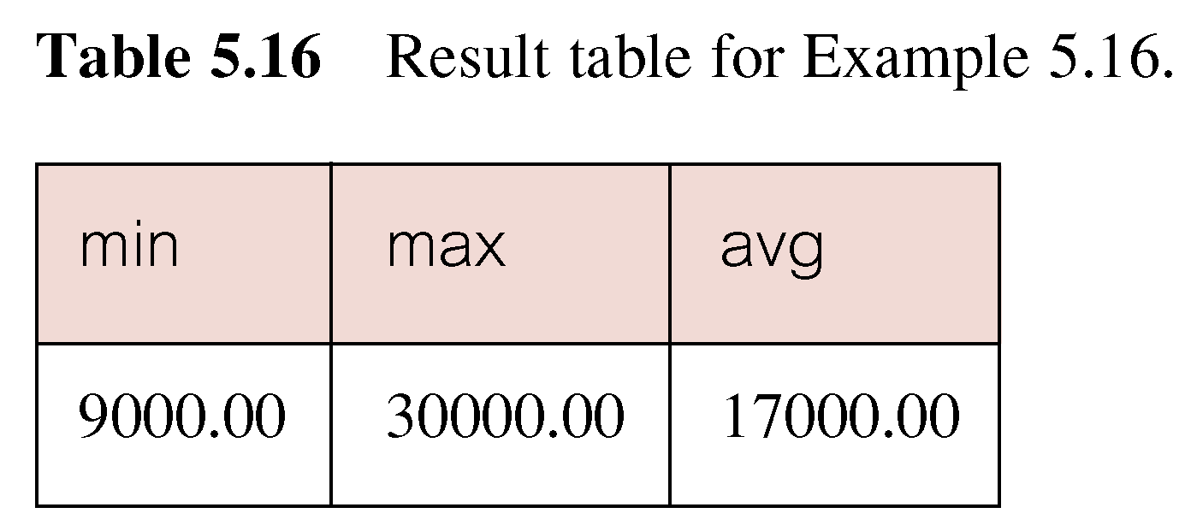
Example: Use of MIN, MAX, AVG
Find minimum, maximum, and average staff salary.
SELECT MIN(salary) AS min,
  MAX(salary) AS max,
  AVG(salary) AS avg
  FROM Staff;

Slide 50
SELECT Statement - Grouping
Use GROUP BY clause to get sub-totals.
SELECT and GROUP BY closely integrated: each item in SELECT list must be single-valued per group, and SELECT clause may only contain:
  column names
  aggregate functions
  constants
  expression involving combinations of the above.

Slide 51
SELECT Statement - Grouping
All column names in SELECT list must appear in GROUP BY clause unless name is used only in an aggregate function.
If WHERE is used with GROUP BY, WHERE is applied first, then groups are formed from remaining rows satisfying predicate.
ISO considers two nulls to be equal for purposes of GROUP BY.

Slide 52
Example: Use of GROUP BY
Find number of staff in each branch and their total salaries.
  SELECT branchNo, COUNT(staffNo) AS count,
    SUM(salary) AS sum
    FROM Staff
    GROUP BY branchNo
    ORDER BY branchNo;

Slide 53
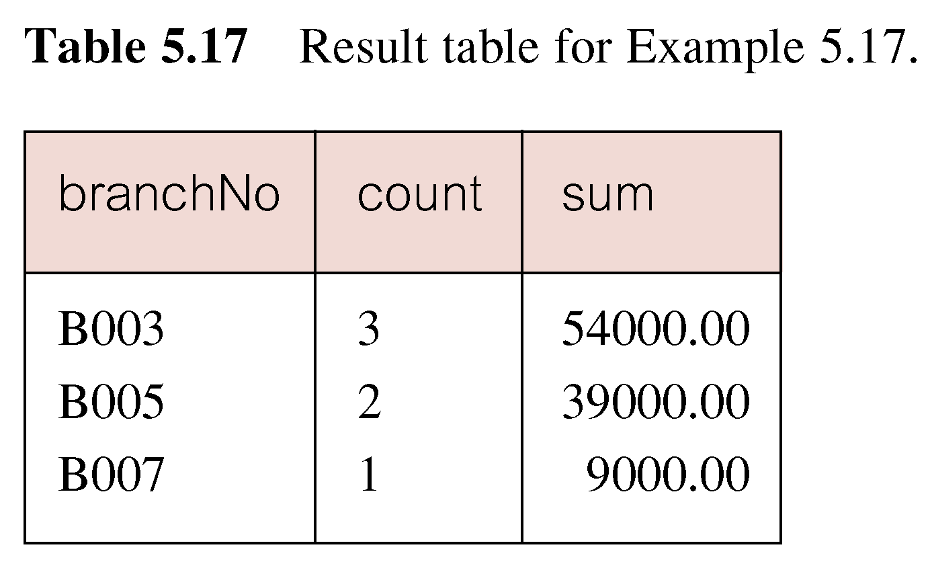
Example: Use of GROUP BY

Slide 54
Restricted Groupings – HAVING clause
HAVING clause is designed for use with GROUP BY to restrict groups that appear in final result table.
Similar to WHERE, but WHERE filters individual rows whereas HAVING filters groups.
Column names in HAVING clause must also appear in the GROUP BY list or be contained within an aggregate function.

Slide 55
Example – Use of HAVING
For each branch with more than 1 member of staff,
find number of staff in each branch and sum of
their salaries.
  SELECT branchNo,
  COUNT(staffNo) AS count,
    SUM(salary) AS sum
    FROM Staff
    GROUP BY branchNo
    HAVING COUNT(staffNo) > 1
    ORDER BY branchNo;

Slide 56
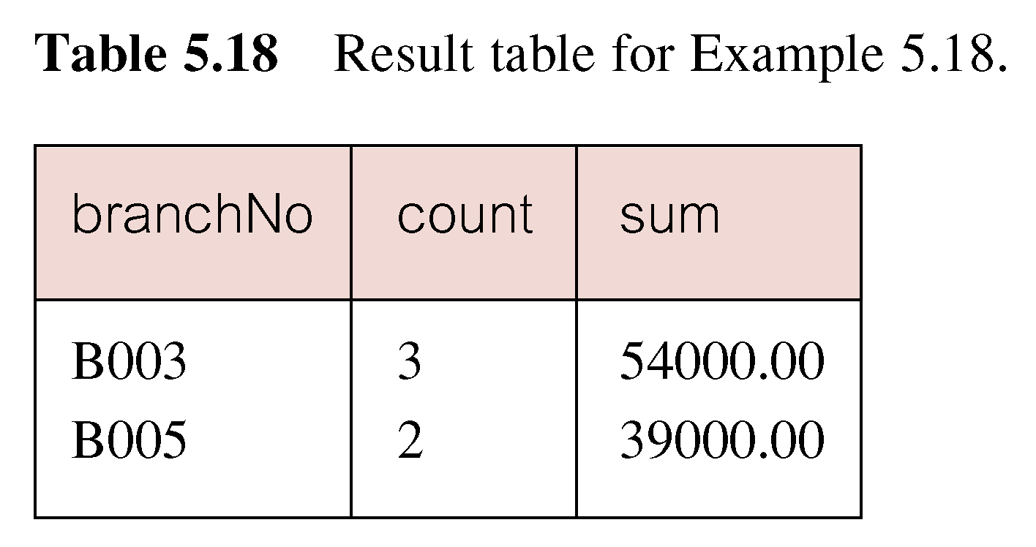
Example: Use of HAVING

Slide 57
Subqueries
Some SQL statements can have a SELECT embedded within them.
A subselect can be used in WHERE and HAVING clauses of an outer SELECT, where it is called a subquery or nested query.
Subselects may also appear in INSERT, UPDATE, and DELETE statements

Slide 58
Example: Subquery with Equality
List staff who work in branch at ‘163 Main St’.
SELECT staffNo, fName, lName, position
  FROM Staff
  WHERE branchNo =
  (SELECT branchNo
  FROM Branch
  WHERE street = ‘163 Main St’);

Slide 59
Example: Subquery with Equality
Inner SELECT finds branch number for branch at ‘163 Main St’ (‘B003’).
Outer SELECT then retrieves details of all staff who work at this branch.
Outer SELECT then becomes:
  SELECT staffNo, fName, lName, position
    FROM Staff
    WHERE branchNo = ‘B003’;

Slide 60
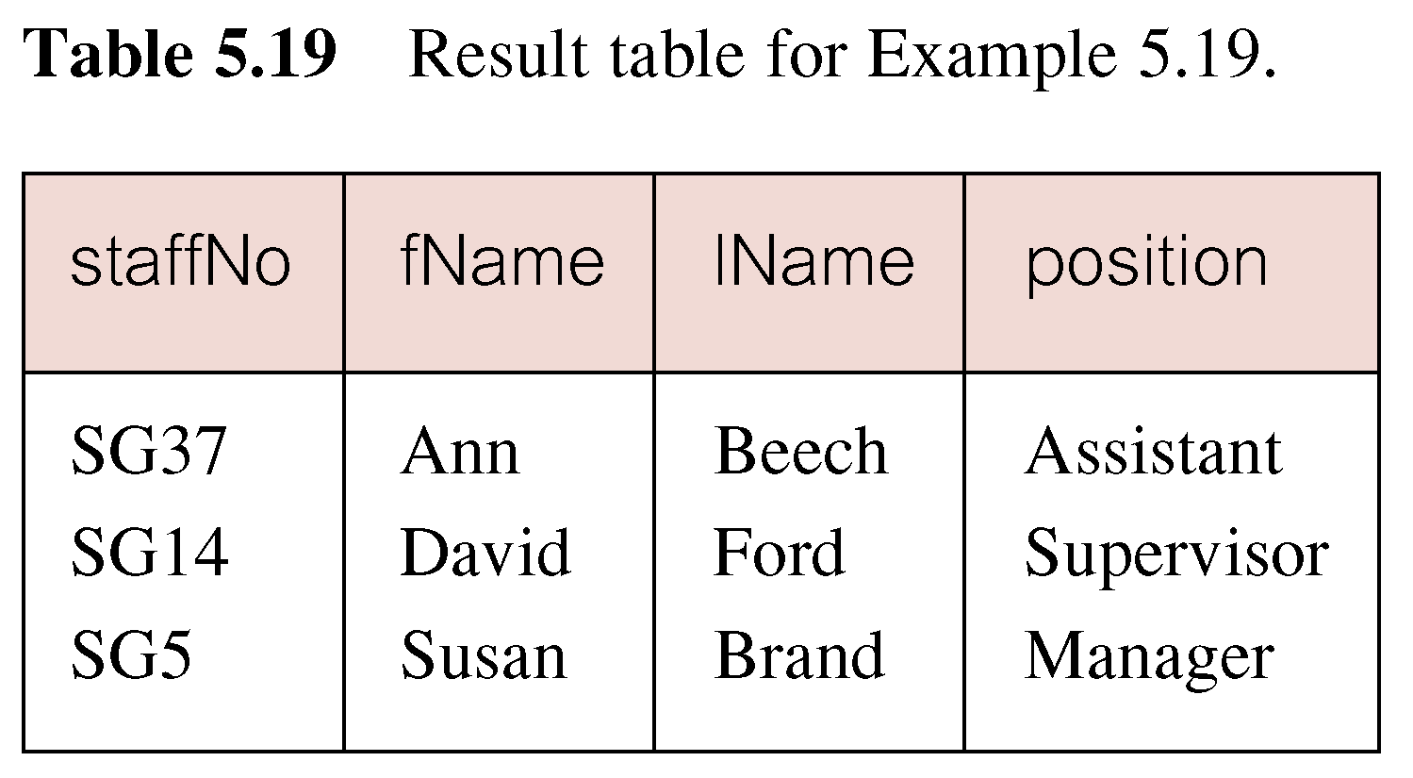
Example: Subquery with Equality

Slide 61
Example: Subquery with Aggregate
List all staff whose salary is greater than the average salary, and show by how much.
  SELECT staffNo, fName, lName, position,
  salary – (SELECT AVG(salary) FROM Staff) As SalDiff
  FROM Staff
  WHERE salary >(SELECT AVG(salary)
    FROM Staff);

Slide 62
Example: Subquery with Aggregate
Cannot write ‘WHERE salary > AVG(salary)’
Instead, use subquery to find average salary (17000), and then use outer SELECT to find those staff with salary greater than this:
  SELECT staffNo, fName, lName, position,
  salary – 17000 As salDiff
  FROM Staff
  WHERE salary > 17000;

Slide 63
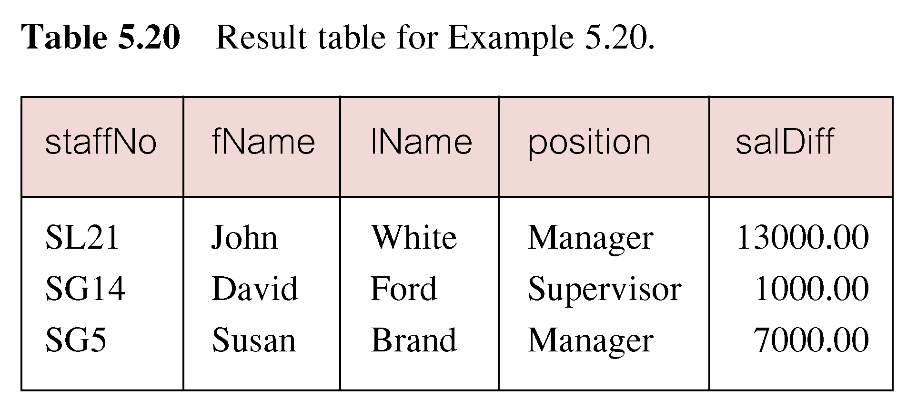
Example: Subquery with Aggregate

Slide 64
Subquery Rules
ORDER BY clause may not be used in a subquery (although it may be used in outermost SELECT).
Subquery SELECT list must consist of a single column name or expression, except for subqueries that use EXISTS.
By default, column names refer to table name in FROM clause of subquery. Can refer to a table in FROM using an alias.

Slide 65
Subquery Rules
When subquery is an operand in a comparison, subquery must appear on right-hand side.
A subquery may not be used as an operand in an expression.

Slide 66
Example: Nested subquery: use of IN
List properties handled by staff at ‘163 Main St’.
  SELECT propertyNo, street, city, postcode, type, rooms, rent
  FROM PropertyForRent
  WHERE staffNo IN
    (SELECT staffNo
    FROM Staff
    WHERE branchNo =
    (SELECT branchNo
    FROM Branch
    WHERE street = ‘163 Main St’));

Slide 67
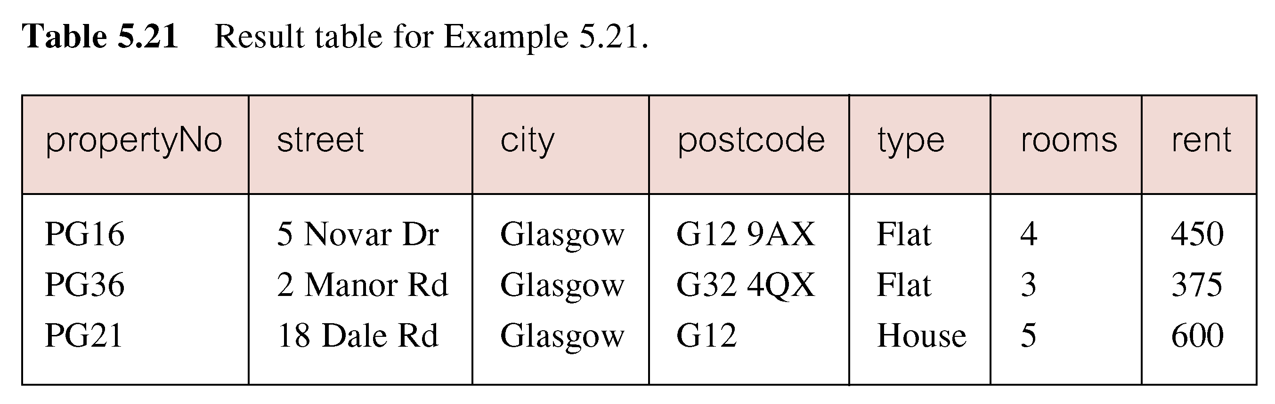
Example: Nested subquery: use of IN

Slide 68
Multi-Table Queries
Can use subqueries provided result columns come from same table.
If result columns come from more than one table must use a join.
To perform join, include more than one table in FROM clause.
Use comma as separator and typically include WHERE clause to specify join column(s).

Slide 69
Multi-Table Queries
Also possible to use an alias for a table named in FROM clause.
Alias is separated from table name with a space.
Alias can be used to qualify column names when there is ambiguity

Slide 70
Example: Simple Join
List names of all clients who have viewed a property along with any comment supplied.
SELECT c.clientNo, fName, lName, propertyNo, comment
  FROM Client c, Viewing v
  WHERE c.clientNo = v.clientNo;

Slide 71
Example: Simple Join
Equivalent to equi-join in relational algebra.
Only those rows from both tables that have identical values in the clientNo columns (c.clientNo = v.clientNo) are included in result.

Slide 72
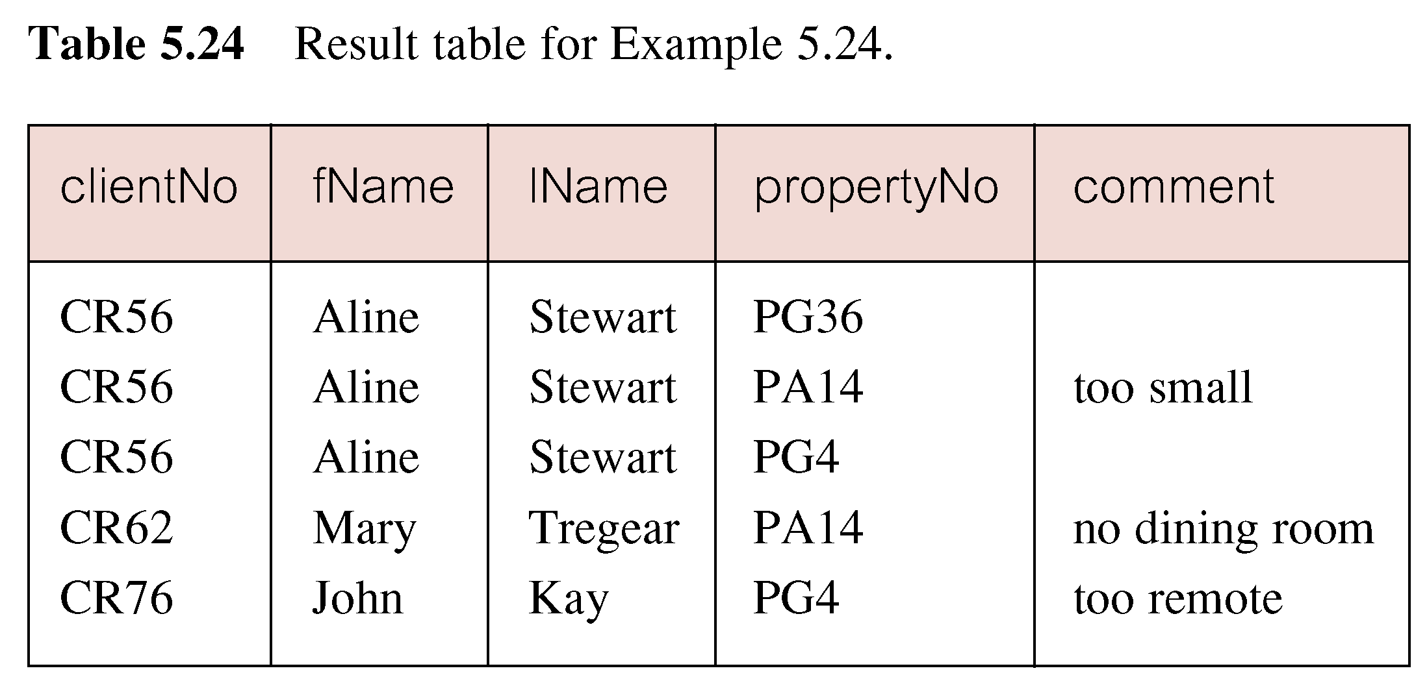
Example: Simple Join

Slide 73
Alternative JOIN Constructs
SQL provides alternative ways to specify joins:
FROM Client c JOIN Viewing v ON c.clientNo = v.clientNo
FROM Client JOIN Viewing USING clientNo
FROM Client NATURAL JOIN Viewing
In each case, FROM replaces original FROM and WHERE. However, first produces table with two identical clientNo columns.

Slide 74
Example: Sorting a join
For each branch, list numbers and names of staff who manage properties, and properties they manage.
SELECT s.branchNo, s.staffNo, fName, lName,propertyNo
  FROM Staff s, PropertyForRent p
  WHERE s.staffNo = p.staffNo
  ORDER BY s.branchNo, s.staffNo, propertyNo;

Slide 75
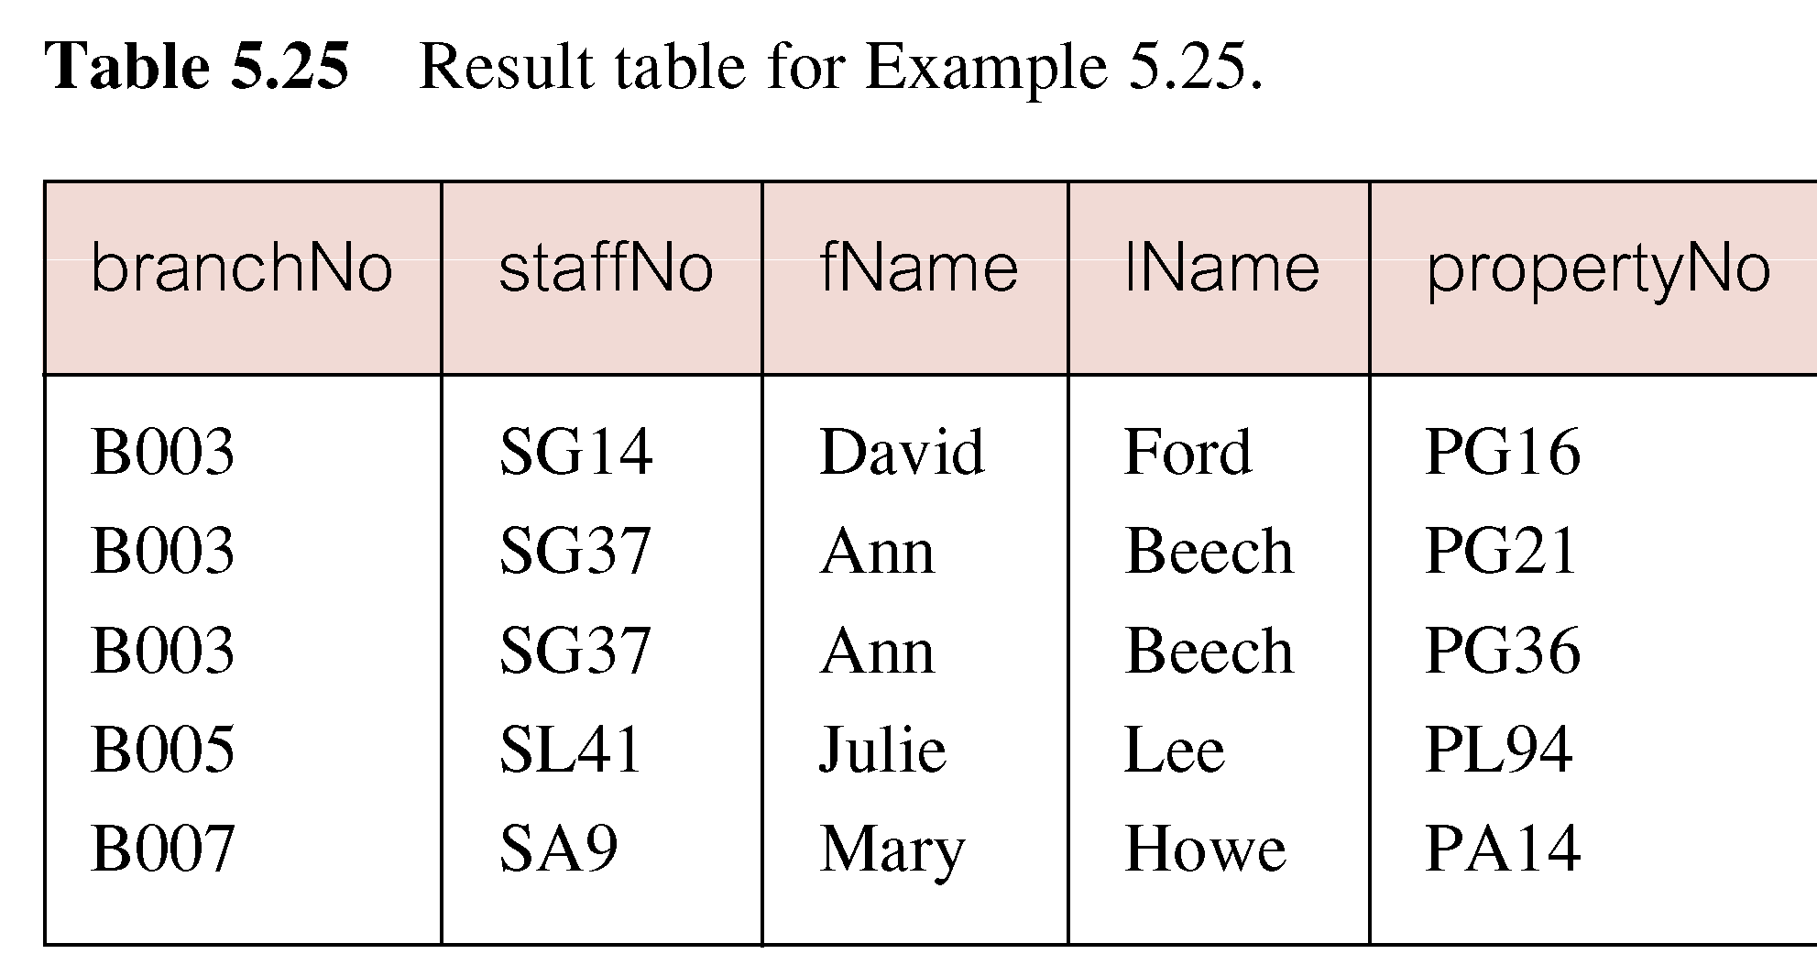
Example: Sorting a join

Slide 76
Example: Three Table Join
For each branch, list staff who manage properties, including city in which branch is located and properties they manage.
SELECT b.branchNo, b.city, s.staffNo, fName, lName,
  propertyNo
  FROM Branch b, Staff s, PropertyForRent p
  WHERE b.branchNo = s.branchNo AND
  s.staffNo = p.staffNo
  ORDER BY b.branchNo, s.staffNo, propertyNo;

Slide 77
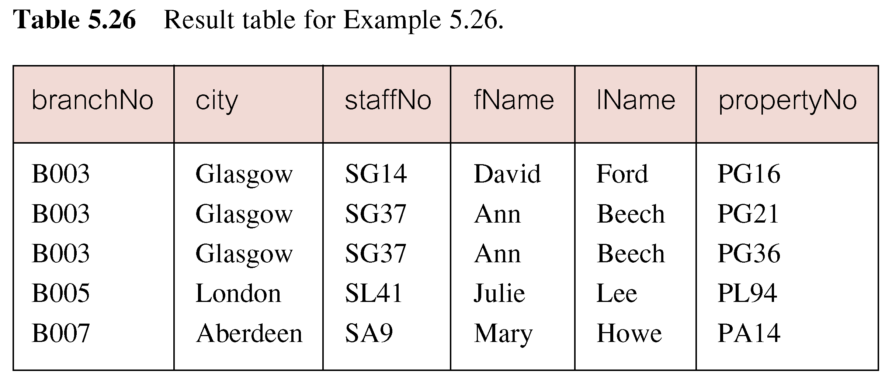
Example: Three Table Join
Alternative formulation for FROM and WHERE:
  FROM (Branch b JOIN Staff s USING branchNo) AS
  bs JOIN PropertyForRent p USING staffNo

Slide 78
Example : Multiple Grouping Columns
Find number of properties handled by each staff member.
SELECT s.branchNo, s.staffNo, COUNT(*) AS count
  FROM Staff s, PropertyForRent p
  WHERE s.staffNo = p.staffNo
  GROUP BY s.branchNo, s.staffNo
  ORDER BY s.branchNo, s.staffNo;

Slide 79
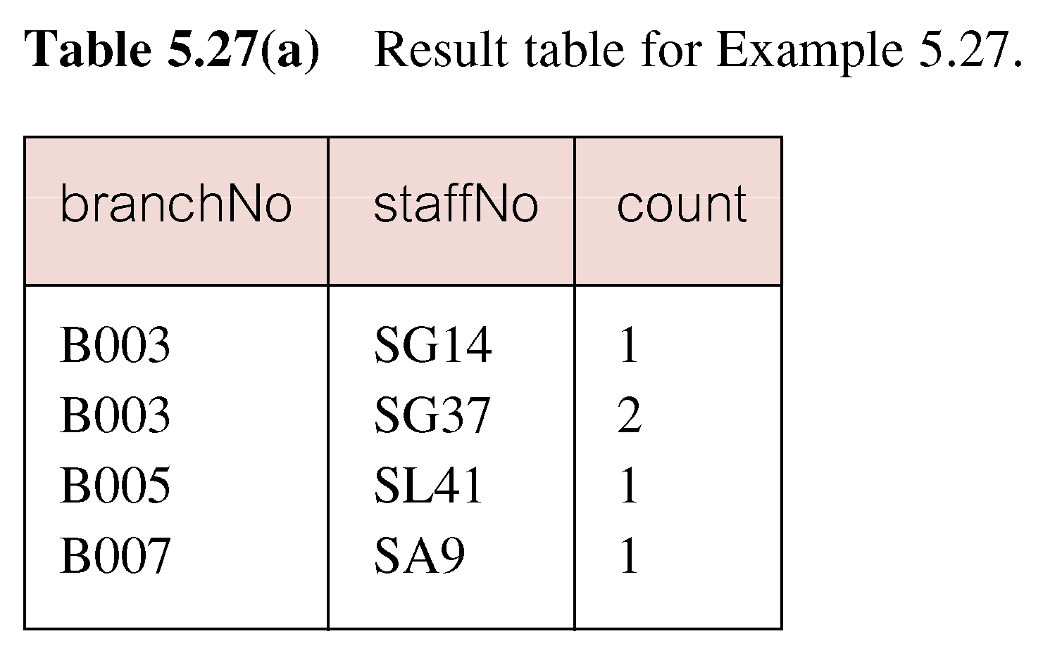
Example : Multiple Grouping Columns

Slide 80
Computing a Join
Procedure for generating results of a join are:
1. Form Cartesian product of the tables named in FROM clause.
2. If there is a WHERE clause, apply the search condition to each row of the product table, retaining those rows that satisfy the condition.
3. For each remaining row, determine value of each item in SELECT list to produce a single row in result table.

Slide 81
Computing a Join
If DISTINCT has been specified, eliminate any duplicate rows from the result table.
5. If there is an ORDER BY clause, sort result table as required.
SQL provides special format of SELECT for Cartesian product:
  SELECT [DISTINCT | ALL] {* | columnList}
  FROM Table1 CROSS JOIN Table2

Slide 82
EXISTS and NOT EXISTS
EXISTS and NOT EXISTS are for use only with subqueries.
Produce a simple true/false result.
True if and only if there exists at least one row in result table returned by subquery.
False if subquery returns an empty result table.
NOT EXISTS is the opposite of EXISTS.

Slide 83
EXISTS and NOT EXISTS
As (NOT) EXISTS check only for existence or non-existence of rows in subquery result table, subquery can contain any number of columns.
Common for subqueries following (NOT) EXISTS to be of form:
  (SELECT * ...)

Slide 84
Example: Query using EXISTS
Find all staff who work in a London branch.
SELECT staffNo, fName, lName, position
  FROM Staff s
  WHERE EXISTS
  (SELECT *
  FROM Branch b
  WHERE s.branchNo = b.branchNo AND
  city = ‘London’);

Slide 85
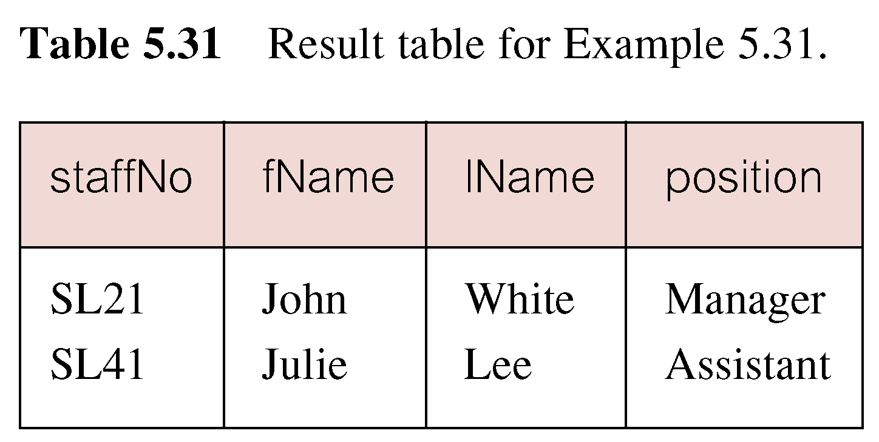
Example: Query using EXISTS

Slide 86
Example: Query using EXISTS
Note, search condition s.branchNo = b.branchNo is necessary to consider correct branch record for each member of staff.
If omitted, would get all staff records listed out because subquery:
  SELECT * FROM Branch WHERE city=‘London’
would always be true and query would be:
  SELECT staffNo, fName, lName, position FROM Staff
  WHERE true;

Slide 87
Example: Query using EXISTS
Could also write this query using join construct:
  SELECT staffNo, fName, lName, position
  FROM Staff s, Branch b
  WHERE s.branchNo = b.branchNo AND
  city = ‘London’;

Slide 88
INSERT
dataValueList must match columnList as follows:
  number of items in each list must be same;
  must be direct correspondence in position of items in two lists;
  data type of each item in dataValueList must be compatible with data type of corresponding column.

Slide 89
Example: INSERT … VALUES
Insert a new row into Staff table supplying data for all columns.
INSERT INTO Staff
  VALUES (‘SG16’, ‘Alan’, ‘Brown’, ‘Assistant’, ‘M’, Date‘1957-05-25’, 8300, ‘B003’);

Slide 90
Example: INSERT using Defaults
Insert a new row into Staff table supplying data for all mandatory columns.
INSERT INTO Staff (staffNo, fName, lName,
  position, salary, branchNo)
  VALUES (‘SG44’, ‘Anne’, ‘Jones’,
  ‘Assistant’, 8100, ‘B003’);
Or
  INSERT INTO Staff
  VALUES (‘SG44’, ‘Anne’, ‘Jones’, ‘Assistant’, NULL,
  NULL, 8100, ‘B003’);

Slide 91
INSERT … SELECT
Second form of INSERT allows multiple rows to be copied from one or more tables to another:
INSERT INTO TableName [ (columnList) ]
  SELECT ...

Slide 92
Example: INSERT … SELECT
Assume there is a table StaffPropCount that contains names of staff and number of properties they manage:
  StaffPropCount(staffNo, fName, lName, propCnt)
Populate StaffPropCount using Staff and PropertyForRent tables.

Slide 93
Example: INSERT … SELECT
  INSERT INTO StaffPropCount
  (SELECT s.staffNo, fName, lName, COUNT(*)
  FROM Staff s, PropertyForRent p
  WHERE s.staffNo = p.staffNo
  GROUP BY s.staffNo, fName, lName)
  UNION
  (SELECT staffNo, fName, lName, 0
  FROM Staff
  WHERE staffNo NOT IN
  (SELECT DISTINCT staffNo
  FROM PropertyForRent));

Slide 94
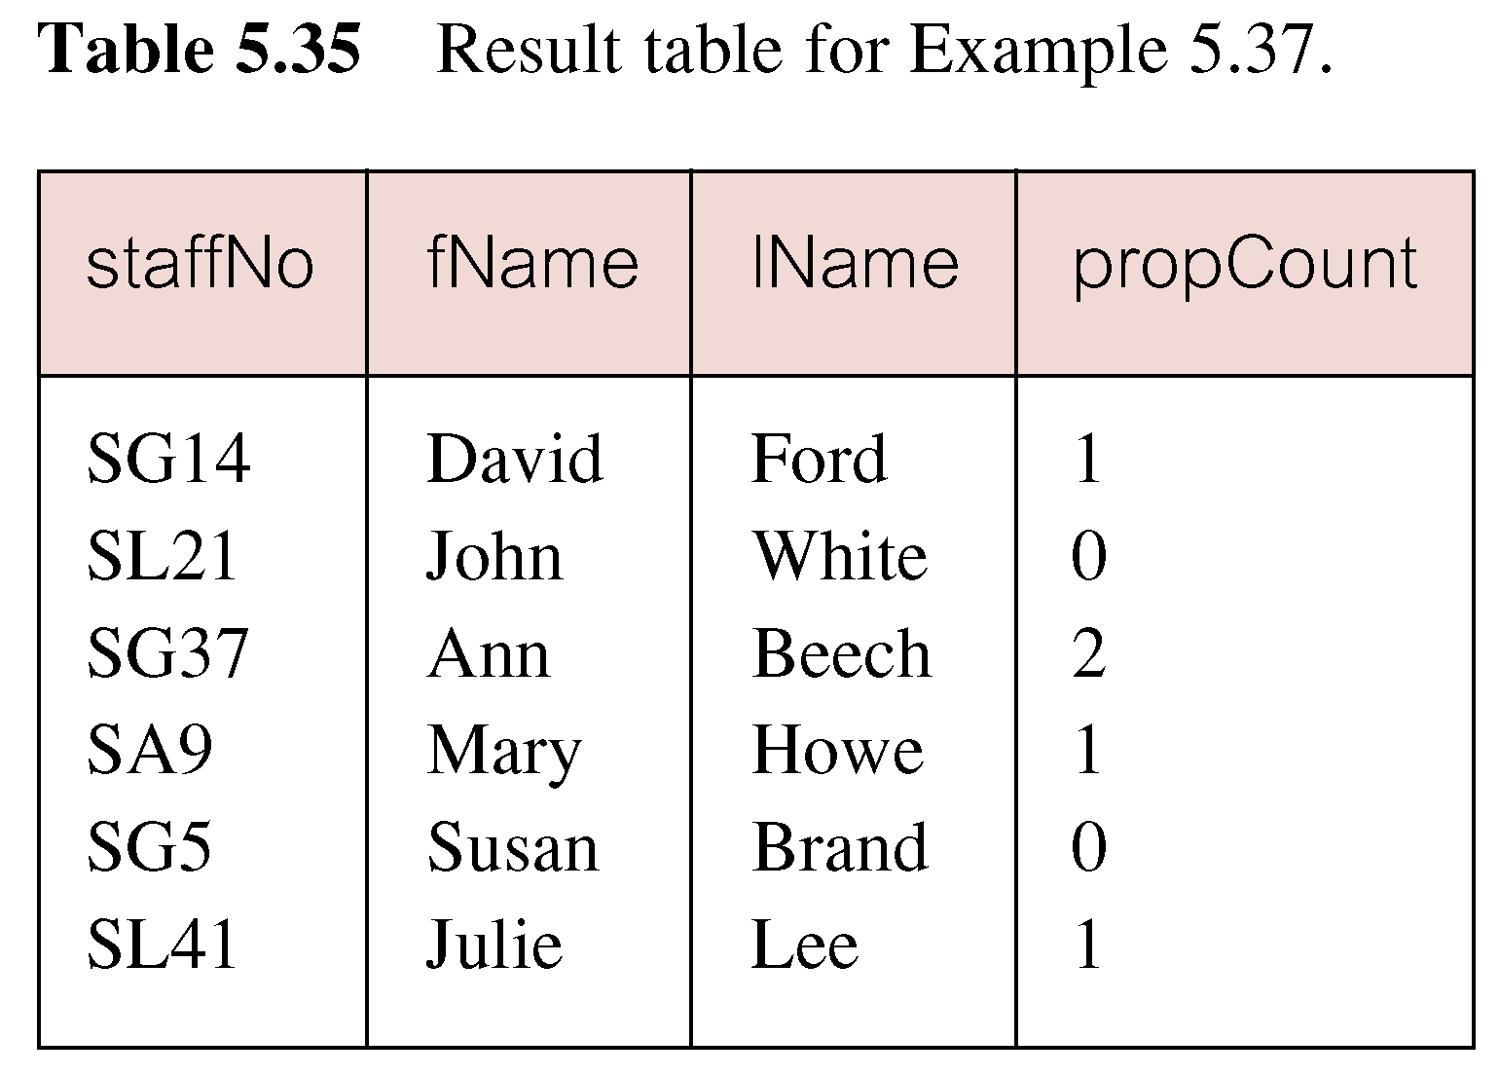
Example: INSERT … SELECT
If second part of UNION is omitted, excludes those staff who currently do not manage any properties.

Slide 95
UPDATE
  UPDATE TableName
  SET columnName1 = dataValue1
  [, columnName2 = dataValue2...]
  [WHERE searchCondition]
TableName can be name of a base table or an updatable view.
SET clause specifies names of one or more columns that are to be updated.

Slide 96
UPDATE
WHERE clause is optional:
  if omitted, named columns are updated for all rows in table;
  if specified, only those rows that satisfy searchCondition are updated.
New dataValue(s) must be compatible with data type for corresponding column.

Slide 97
Example: UPDATE All Rows
UPDATE Staff
  SET salary = salary*1.03;
Give all Managers a 5% pay increase.
UPDATE Staff
  SET salary = salary*1.05
  WHERE position = ‘Manager’;

Slide 98
Example: UPDATE Multiple Columns
Promote David Ford (staffNo=‘SG14’) to Manager and change his salary to £18,000.
UPDATE Staff
  SET position = ‘Manager’, salary = 18000
  WHERE staffNo = ‘SG14’;

Slide 99
DELETE
  DELETE FROM TableName
  [WHERE searchCondition]
TableName can be name of a base table or an updatable view.
searchCondition is optional; if omitted, all rows are deleted from table. This does not delete table. If search_condition is specified, only those rows that satisfy condition are deleted.

Slide 100
Example: DELETE Specific Rows
Delete all viewings that relate to property PG4.
DELETE FROM Viewing
  WHERE propertyNo = ‘PG4’;
Delete all records from the Viewing table.
  DELETE FROM Viewing;

Slide 101
Quick Review Questions
List the objectives of SQL.
Describe the importance of SQL.
What are literals?
List the SQL commands used for a range search condition.
List the SQL command used for pattern matching.
List the SQL command used for single column ordering.
Name all possible aggregates used in a SELECT statement.
List the rules used in subqueries.
Differentiate between EXISTS and NOT EXISTS.

Slide 102
Summary
Basic DML commands.
How to update database using INSERT, UPDATE, and DELETE.

Slide 103
Question and Answer Session
Q & A

